Slide 1
Preprocessed BED dataset
By: Steven Cao

Slide 2
Preprocessed BED dataset for Rest Closed Stimulus
Raw BED dataset for RC Stimulus
21 subjects with 3 sessions
14 EEG channels
RC stimulus is 2 minutes of the raw BED dataset for any subject
Number of samples = 30720 (120* 256) for each subject
Preprocessed BED dataset for RC Stimulus
21 subjects with 3 sessions
14 EEG channels
Number of samples for each subject varies from 26991 to 30457 samples

Slide 3

Issue #1
There is no data for subject#1 in the preprocessed BED Dataset for RC
There are files for session#1 and session#2, but contains no data.
session#1: (0,1,284845) #shape
session#2: (0,1,321195) #shape
There is no file for subject#1 for session #3 and subject#11 for session #1

Slide 4
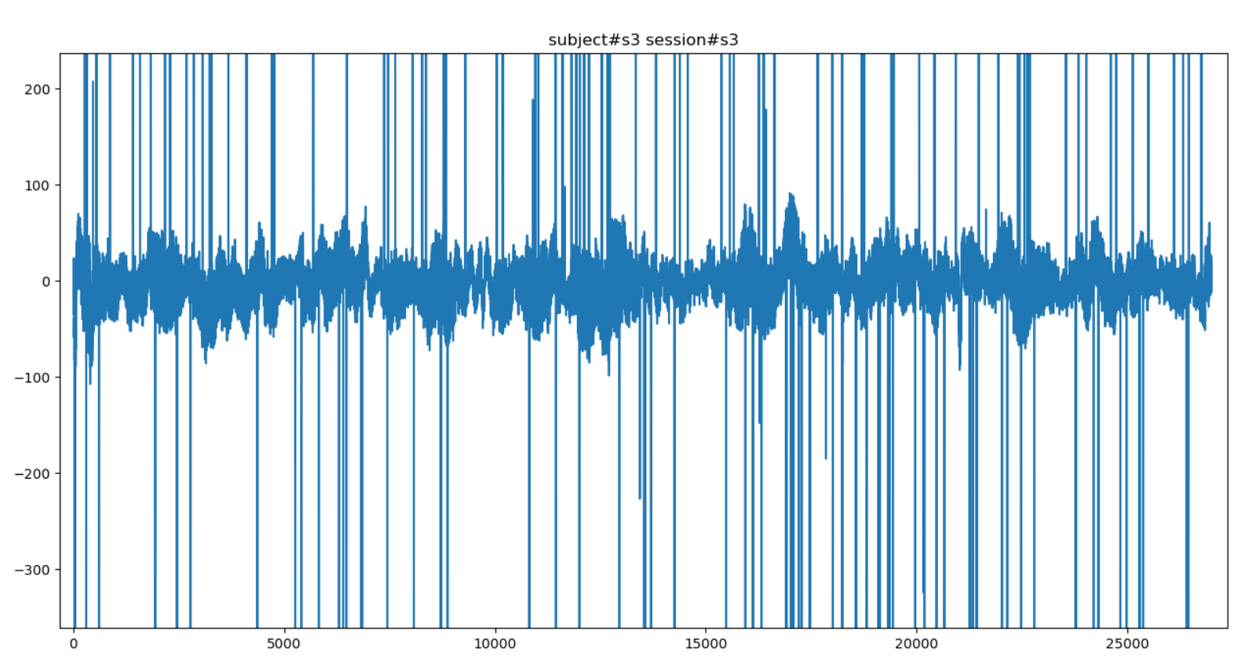
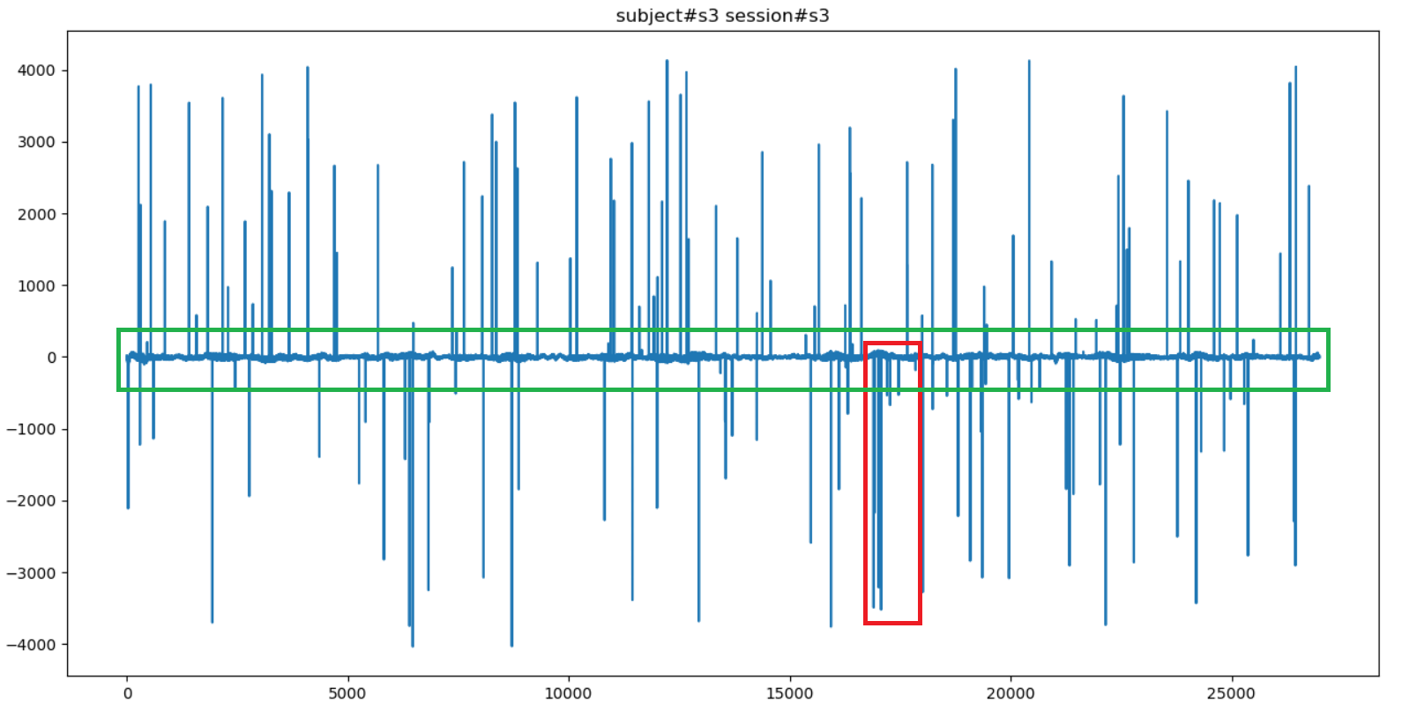
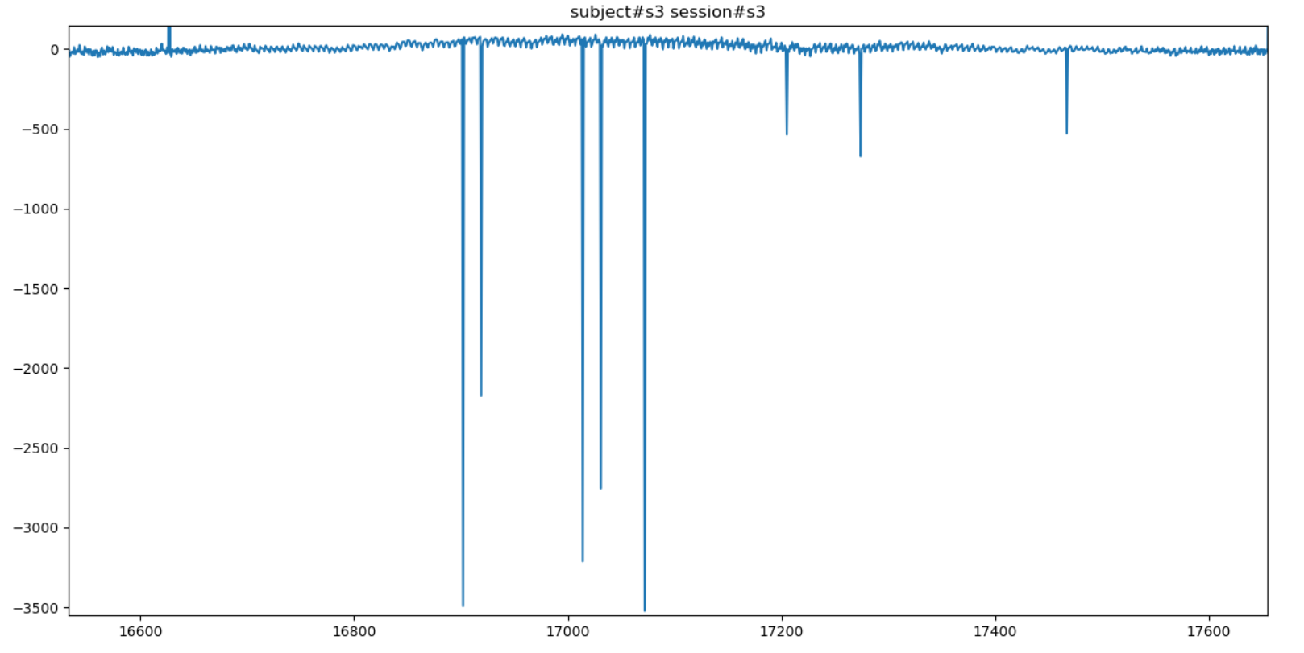
Issue #2 Part 1
Zoomed-in version (green)
Original (one channel)
Zoomed-in version (red)

Slide 5
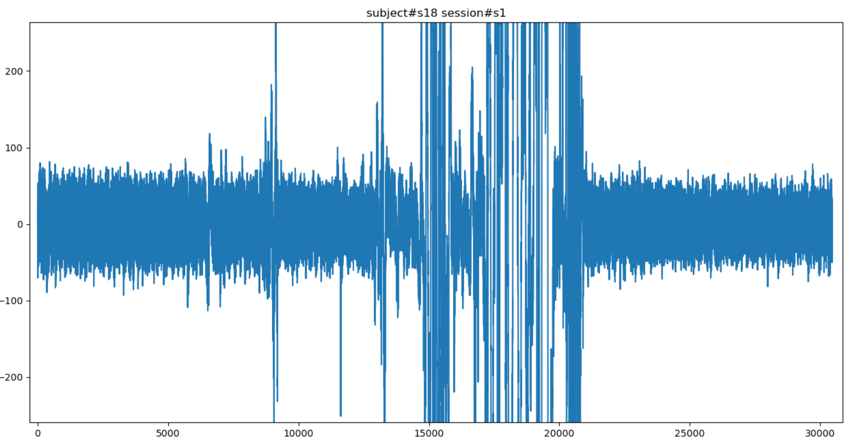
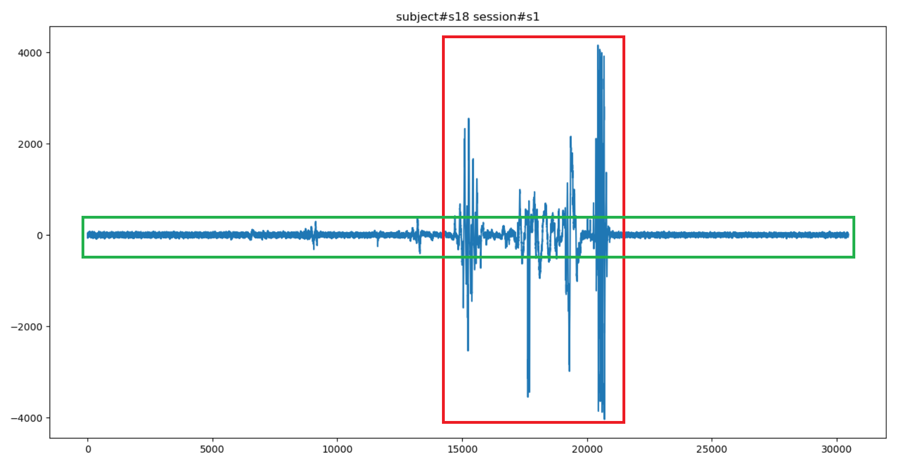
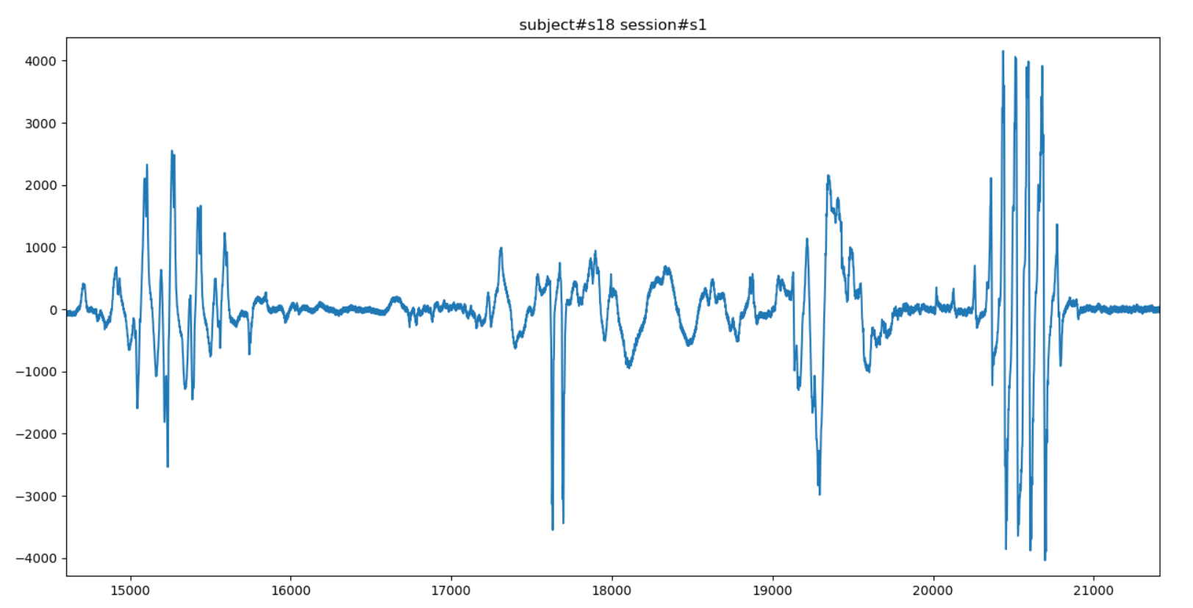
Issue #2 Part 2
Zoomed-in version (green)
Original (one channel)
Zoomed-in version (red)

Slide 6
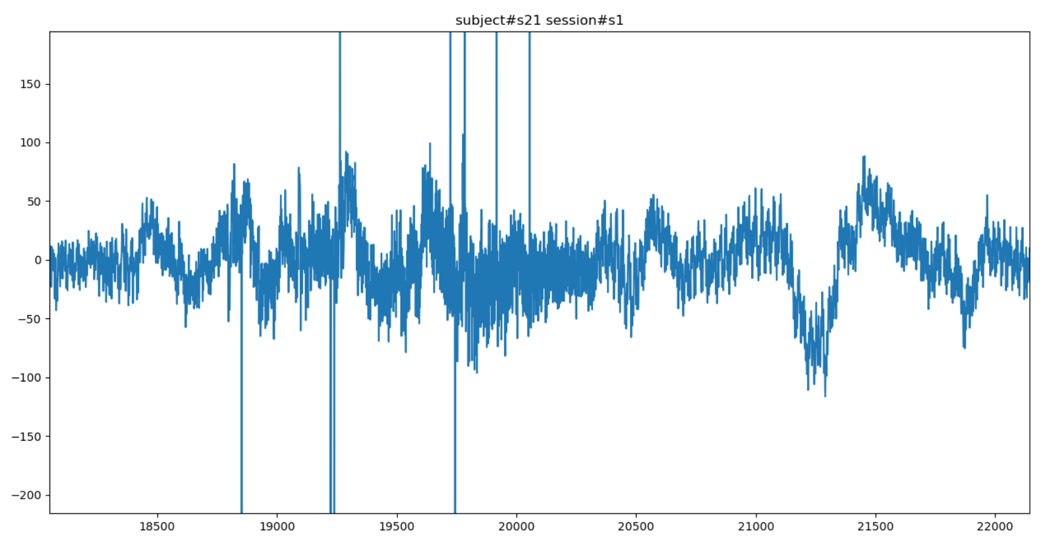
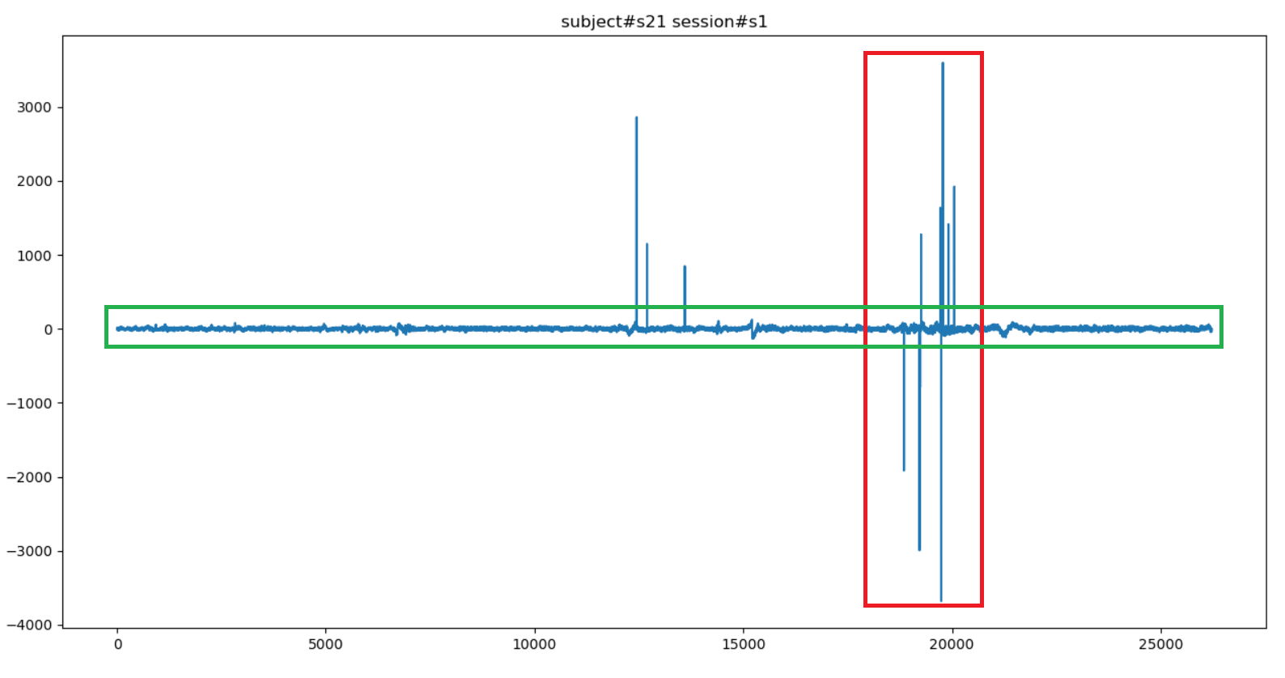
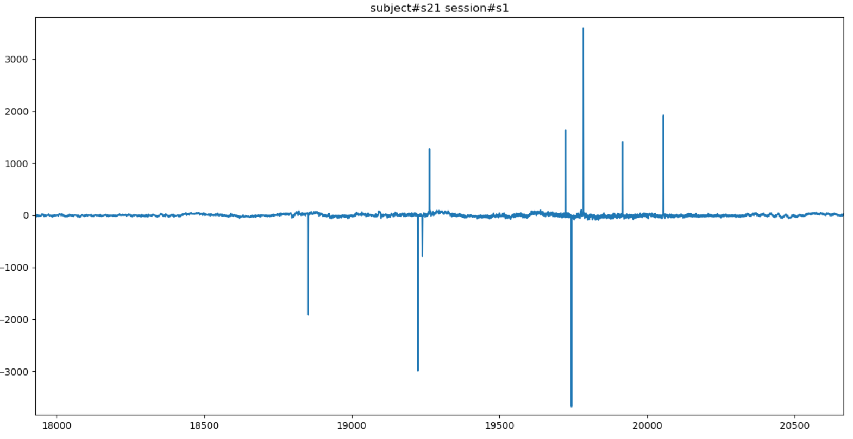
Issue #2 Part 3
Zoomed-in version (green)
Original (one channel)
Zoomed-in version (red)

Slide 7
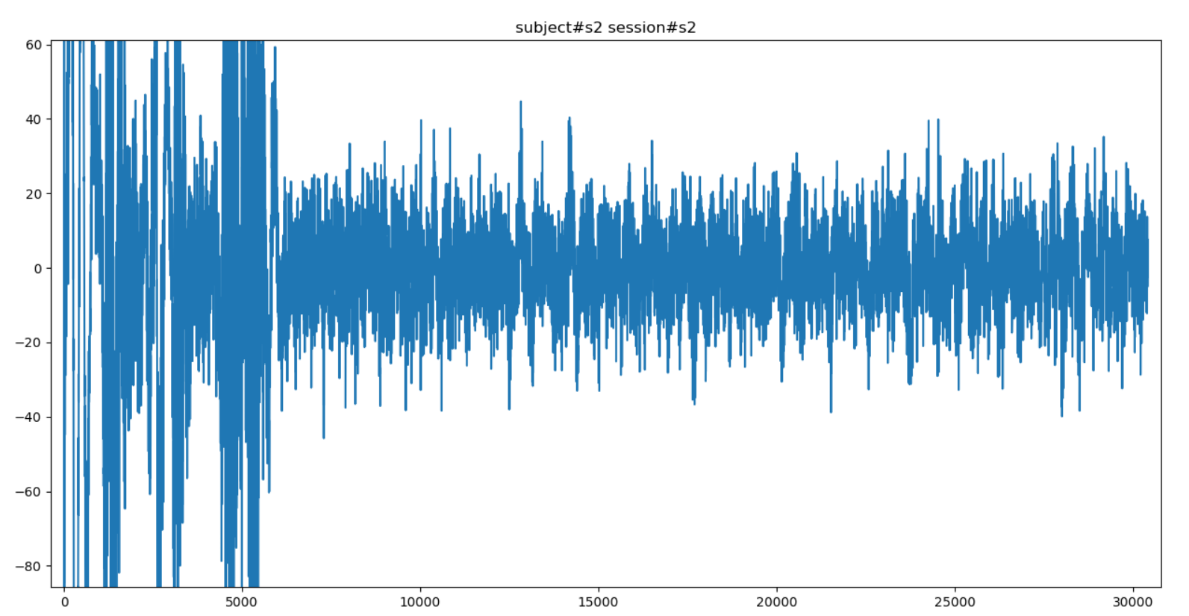
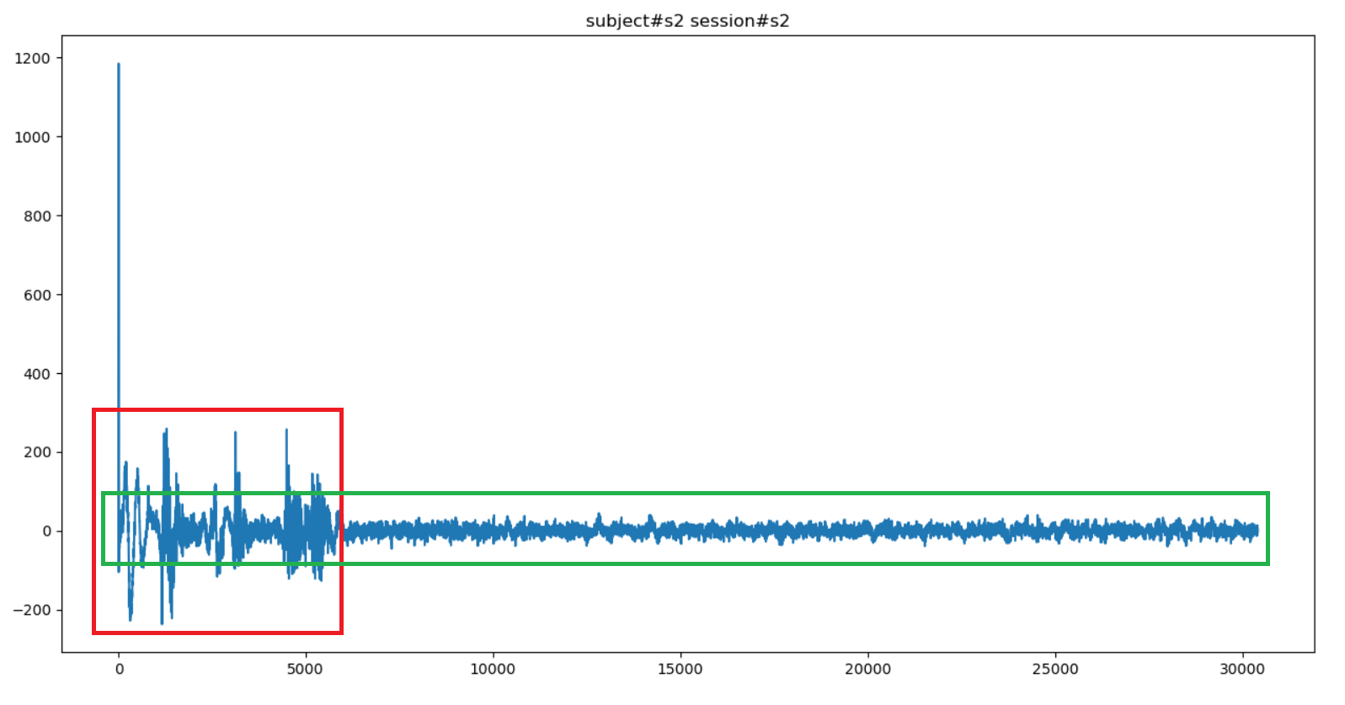
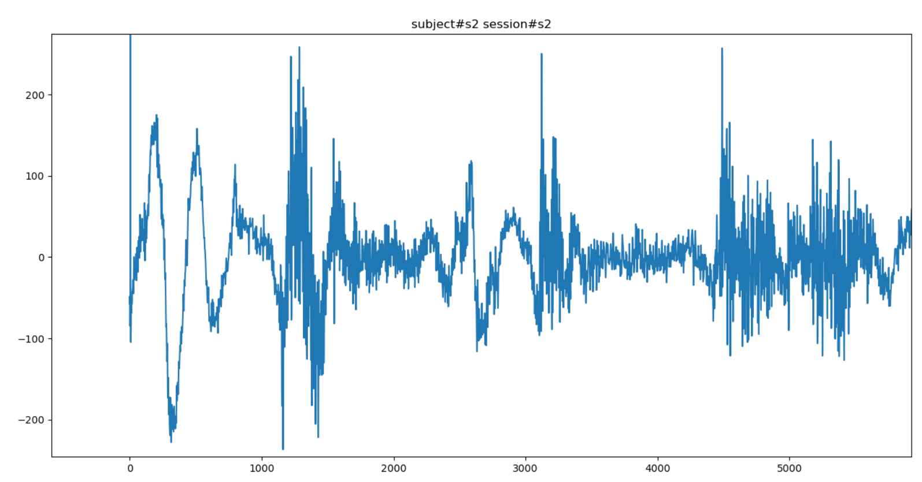
Issue #2 Part 4
Zoomed-in version (green)
Original (one channel)
Zoomed-in version (red)

Slide 8
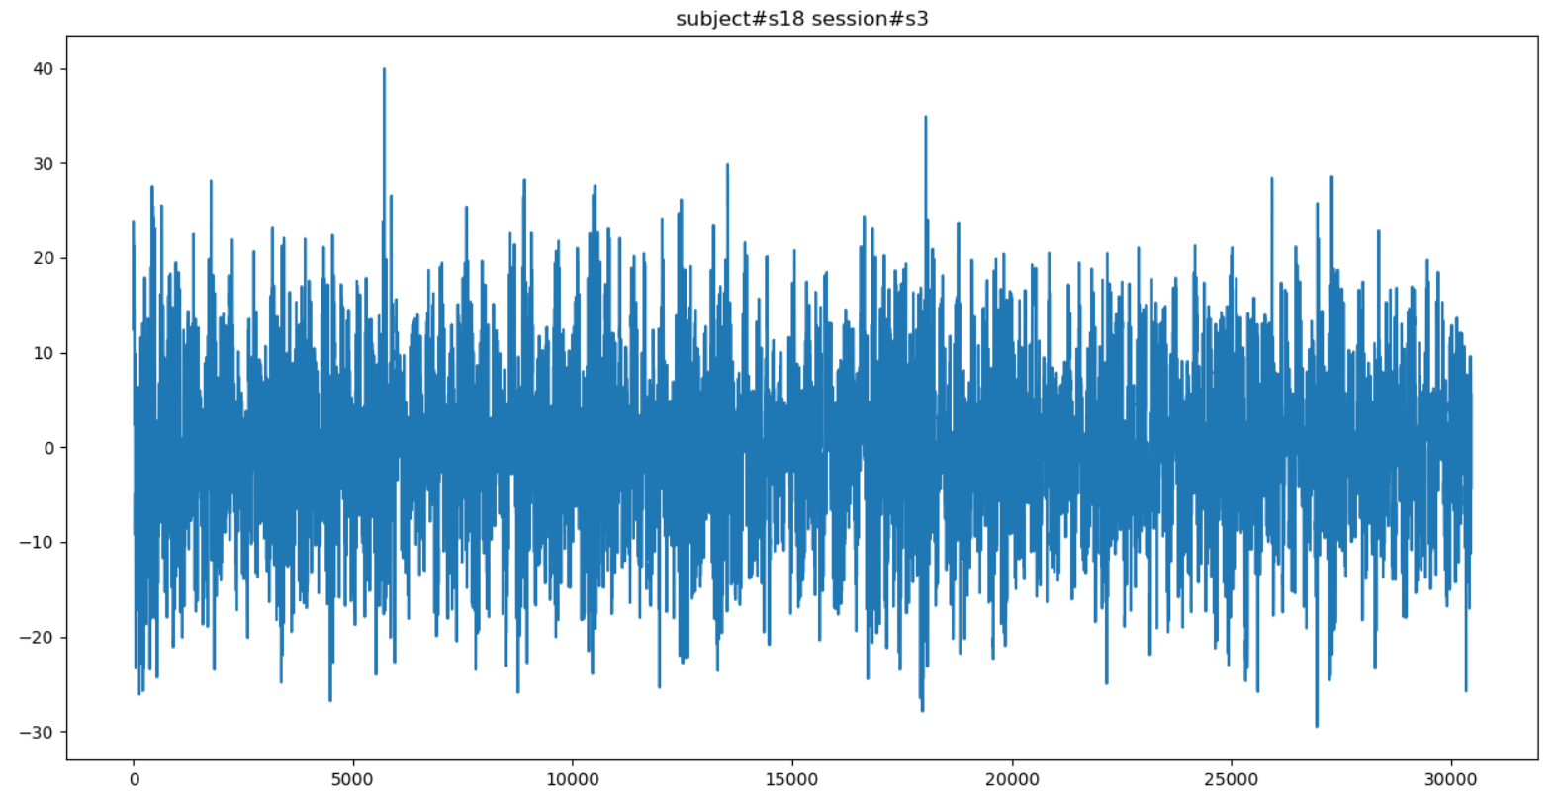
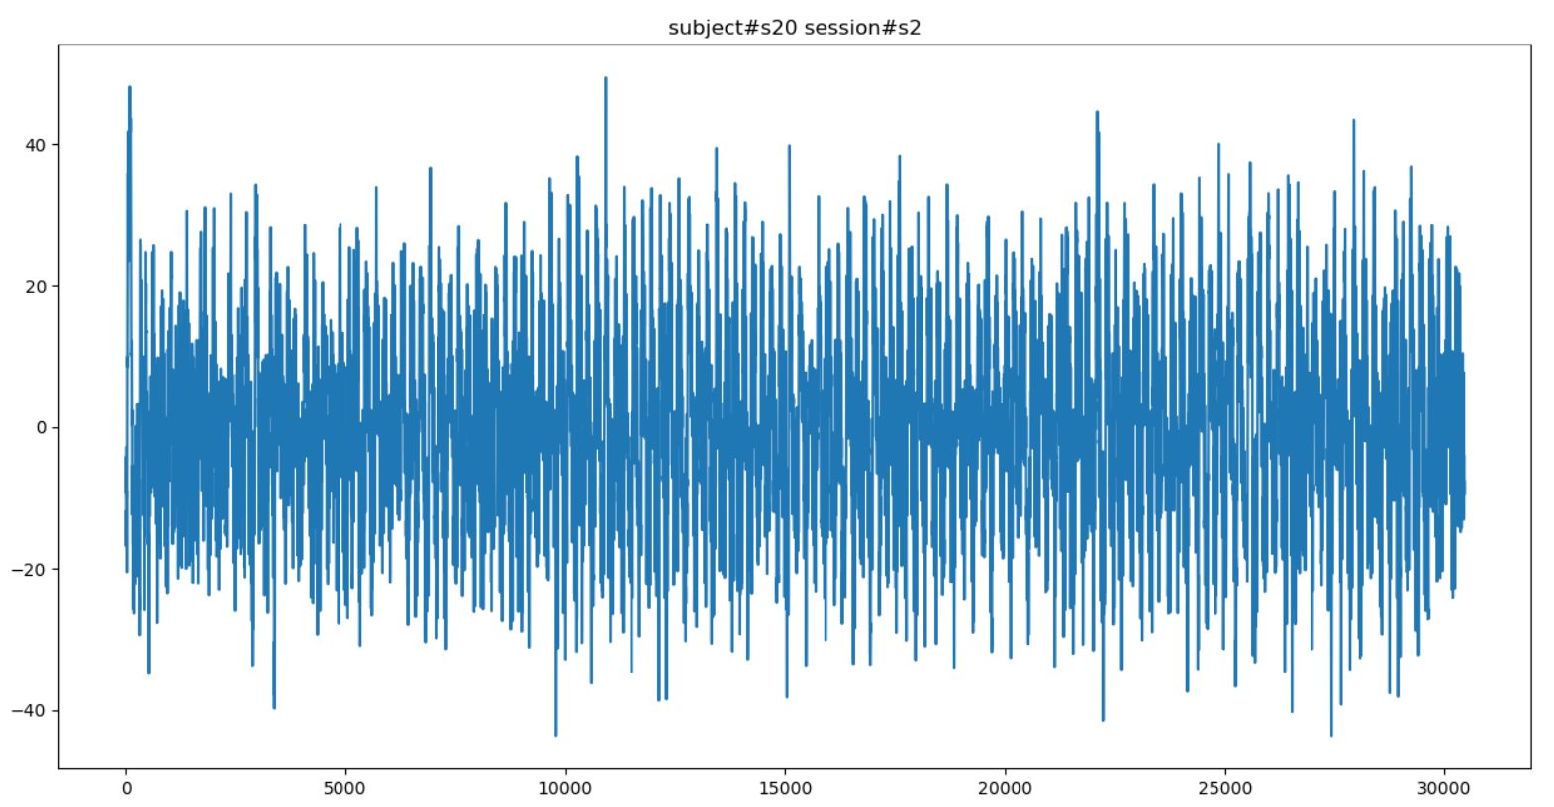
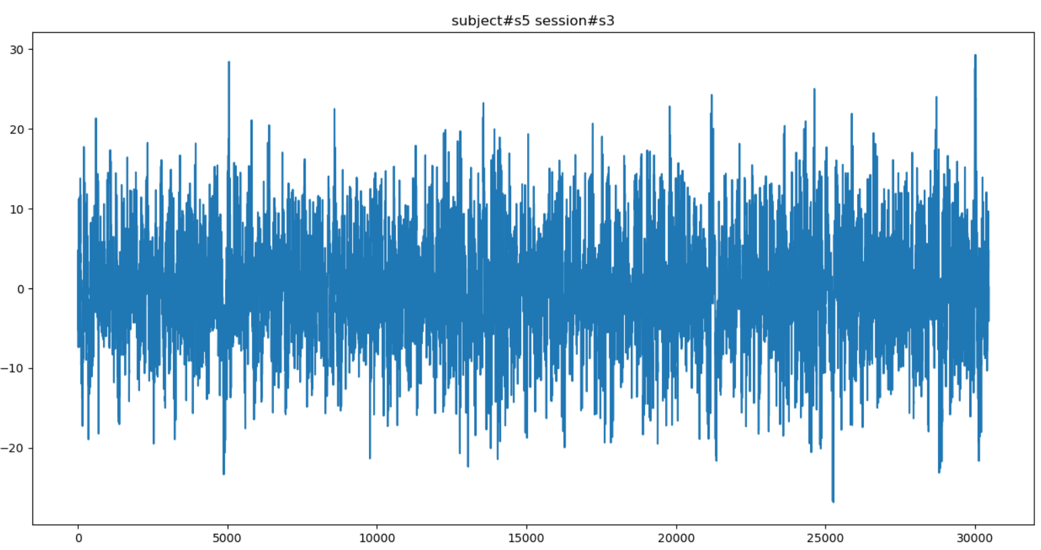
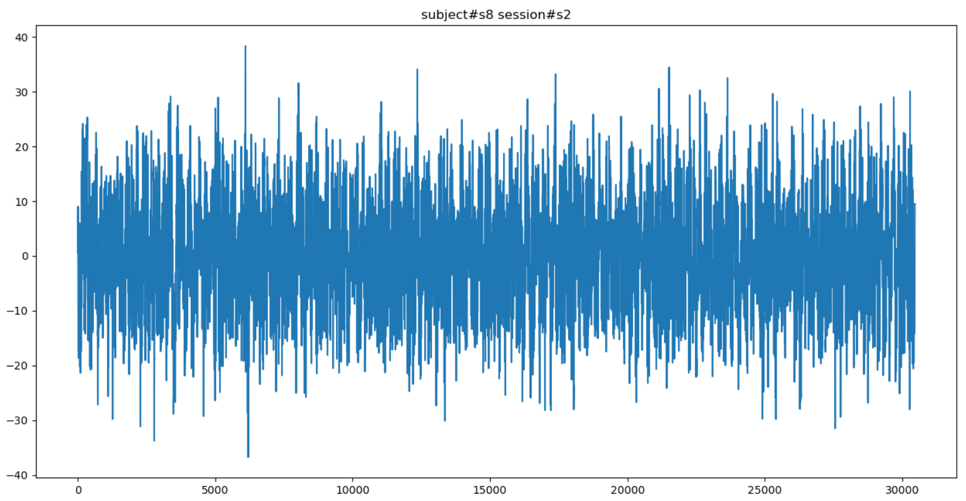
Artifact Removed

